Slide 1

GLASS DOOR-REVIEWS
Done by: Russel, Rehab, Abdulla Hani

Slide 2



GLASSDOOR REVIEW
About Glassdoor Company
Glassdoor is an American website where current and former employees anonymously review companies, operated by the company of the same name.
Features of the Dataset
The columns correspond to the date of the review, the job name, the job location, the status of the reviewers, and the reviews. Reviews are divided in s sub-categories Career Opportunities, Comp & Benefits, Culture & Values, Senior Management, and Work/Life Balance.

Slide 3
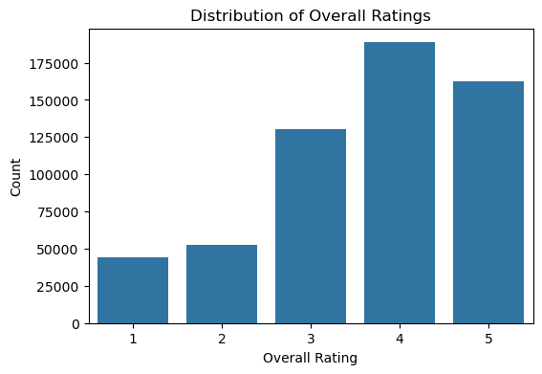
WHAT IS THE DISTRIBUTION OF OVERALL RATINGS?
THE BAR CHART SHOWS THE FREQUENCY OF OVERALL RATINGS.
THE MOST COMMON OVERALL RATING IS 4, WITH A COUNT OF 188,586. RATING 5 IS THE SECOND MOST FREQUENT, WITH OVER 160,000 INSTANCES.

Slide 4
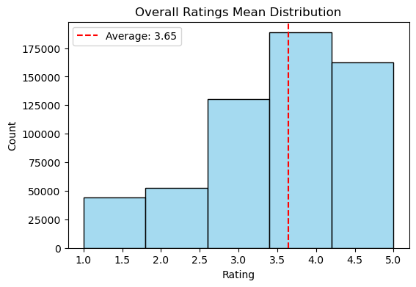
WHAT IS THE AVERAGE RATING ACROSS ALL COMPANIES?
THE HISTOGRAM SHOWS THE FREQUENCY OF THE AVERAGE OF OVERALL RATINGS GIVEN TO COMPANIES AND IT REVEALS THAT THE MOST COMMON OVERALL RATING FALLS WITHIN THE 3.0 TO 4.0 RANGE. A DASHED RED LINE IS INCLUDED TO MARK THE AVERAGE RATING, WHICH IS 3.65.

Slide 5
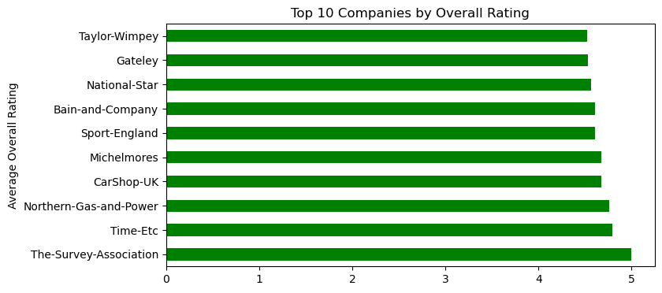
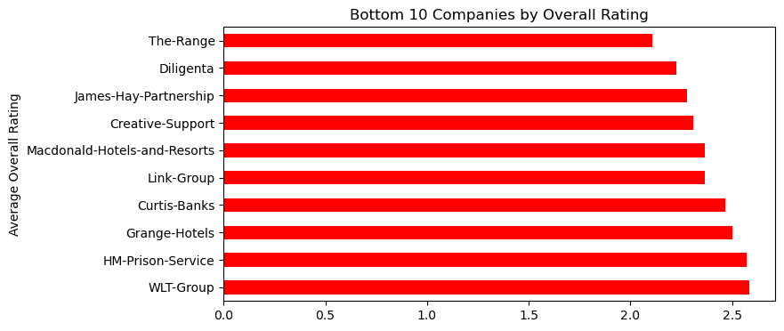
WHICH COMPANIES HAVE THE HIGHEST AND LOWEST AVERAGE RATINGS?
The first bar chart illustrates the top 10 companies that have received the highest overall rating that is greater than 4.5, and the second bar chart presents the bottom 10 companies that have received the lowest overall rating, that is less than 2.5.

Slide 6
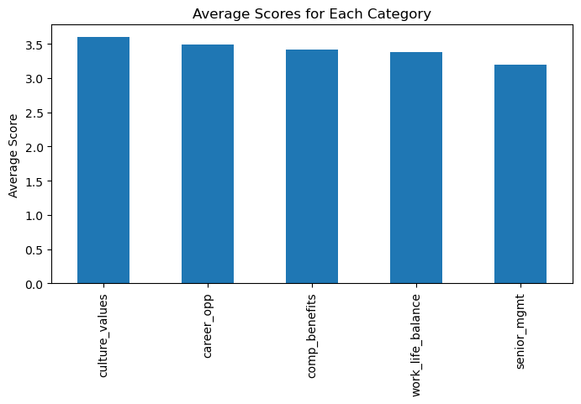
WHAT ARE THE AVERAGE SCORES FOR EACH SUB-RATING?
The bar chart illustrates the average values of each sub-rating category. Culture and values rating has the highest average score, at approximately 3.6. Senior management rating has the lowest average score, at approximately 3.2.

Slide 7
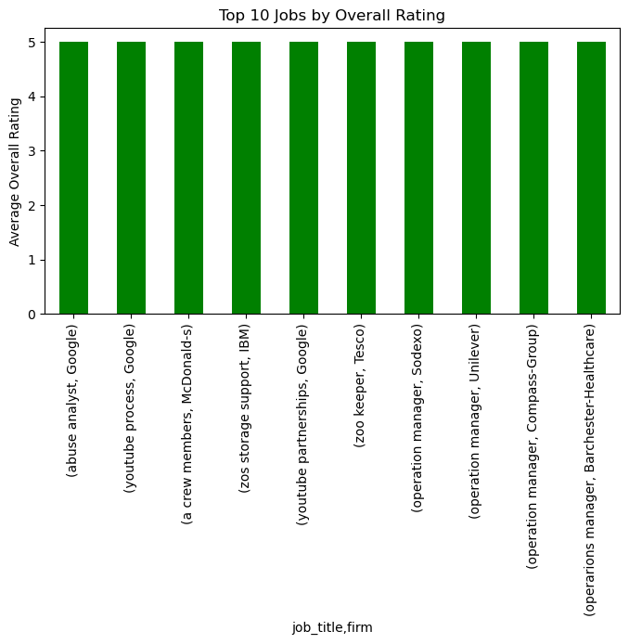
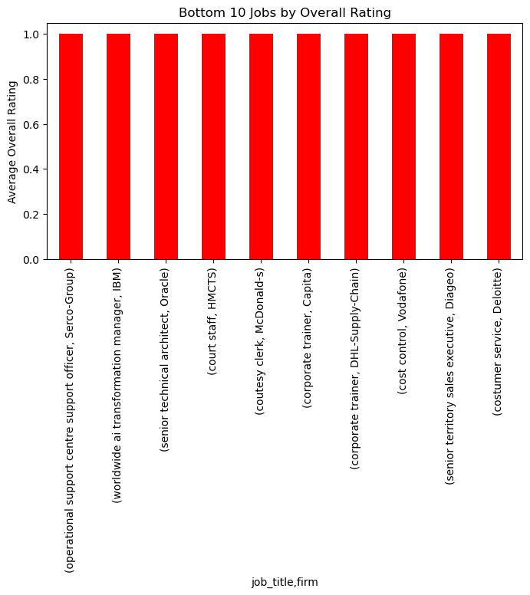
WHICH JOB TITLES HAVE THE HIGHEST AND LOWEST AVERAGE RATINGS?
THE FIRST BAR CHART ILLUSTRATES THE TOP 10 JOBS, ALONG WITH THEIR CORRESPONDING COMPANY NAMES, THAT HAVE RECEIVED A PERFECT RATING OF 5, AND THE SECOND BAR CHART PRESENTS THE BOTTOM 10 JOBS THAT HAVE RECEIVED A RATING OF 1, DENOTING THE LOWEST LEVEL.

Slide 8
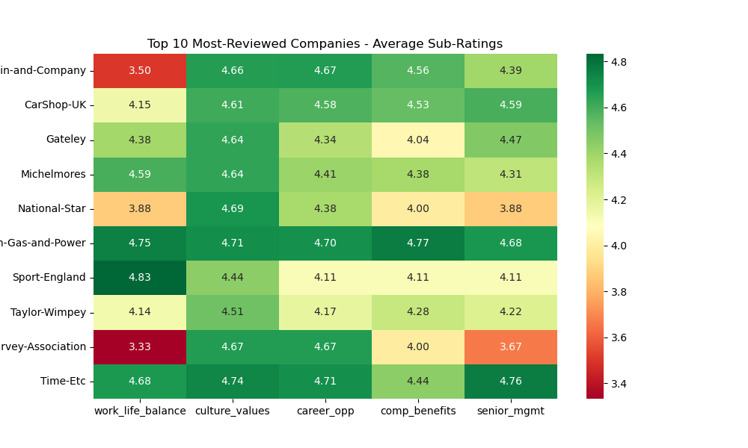
HOW DO THE TOP 5 MOST-REVIEWED COMPANIES COMPARE IN EACH OF THE SUB-RATINGS?
THE HEATMAP REPRESENTS THE SUB-RATINGS FOR THE TOP 10 COMPANIES. OVERALL, THE HEATMAP REVEALS A STRONG PERFORMANCE IN CULTURE AND VALUES AND CAREER OPPORTUNITIES ACROSS MOST COMPANIES. WORK-LIFE BALANCE AND SENIOR MANAGEMENT SHOW MORE VARIABILITY AND LOWER SCORES FOR SOME COMPANIES.

Slide 9
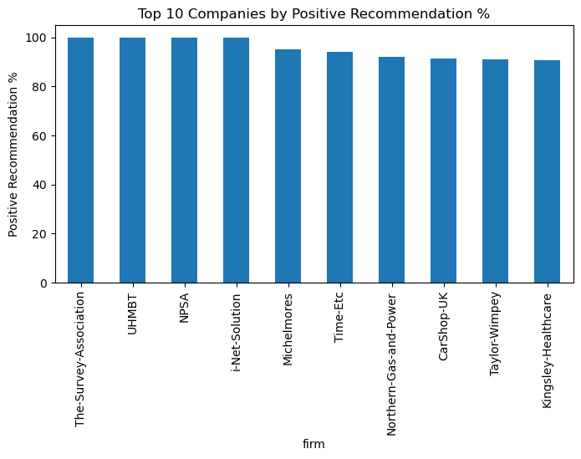
WHICH COMPANY HAS THE HIGHEST POSITIVE RECOMMENDATION PERCENTAGE?
THE BAR CHART SHOWS THE TOP 10 COMPANIES WITH THE HIGHEST POSITIVE RECOMMENDATION PERCENTAGES. NPSA, THE-SURVEY-ASSOCIATION, UHMBT, AND I-NET-SOLUTION HAD A 100% POSITIVE RECOMMENDATION PERCENTAGE.

Slide 10
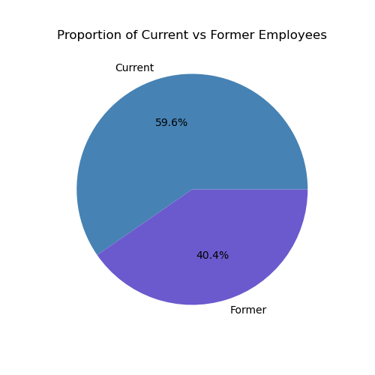
WHAT IS THE PROPORTION OF CURRENT AND FORMER EMPLOYEES IN THE DATASET?
THE PIE CHART SHOWS THE DISTRIBUTION OF REVIEWERS. AMONG THE TOTAL GROUPS, 59.6% ARE CURRENT EMPLOYEES, WHILE 40.4% ARE FORMER EMPLOYEES.

Slide 11
Conclusion
Sample Size
Population
Findings
577,992 reviews from 2008 to 2021
59.6% of the reviewers are current employees, whereas 40.4% are former employees.
The overall rating has a mean of 3.65. The sub-ratings covers 5 main aspects: work-life balance, culture and values, career opportunities, compensation and benefits, and senior management, and have a mean of 3.4, 3.6, 3.5, 3.4 and 3.2, respectively.

Slide 12
THANK YOU

